Slide 1
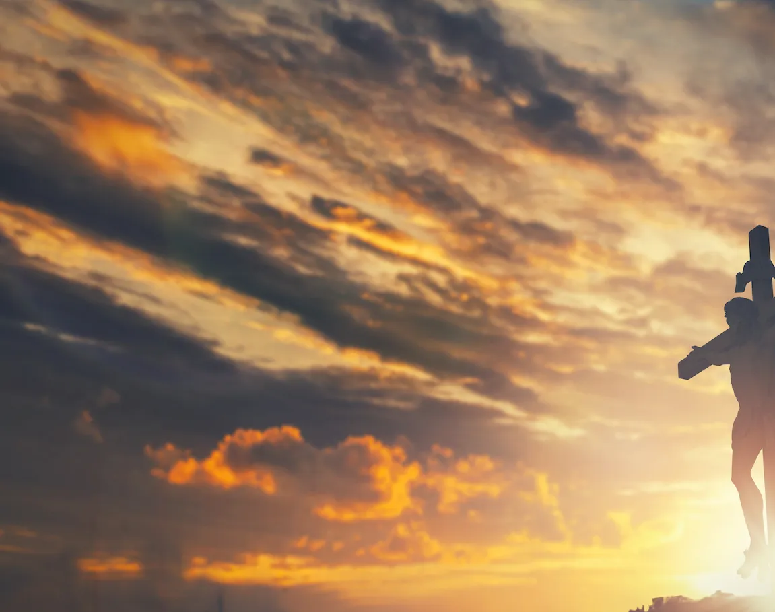
Way Maker

Slide 2
G D A Bm
G D
You are here, moving in our midst
A Bm
I worship You, I worship You
G D
You are here, working in this place
A Bm
I worship You, I worship You
to CHORUS

Slide 3
G
(You are) Way Maker, Miracle Worker
D
Promise Keeper
A
Light in the darkness, my God
Bm
That is who You are
repeat & to VERSE

Slide 4
G D
You are here, touching every heart
A Bm
I worship You, I worship You
G D
You are here, healing every heart
A Bm
I worship You, I worship You
to VERSE

Slide 5
G D
You are here, turning lives around
A Bm
I worship You, I worship You
G D
You are here, mending every heart
A Bm
I worship You, I worship You
to Chorus

Slide 6
G
(You are) Way Maker, Miracle Worker
D
Promise Keeper
A
Light in the darkness, my God
Bm
That is who You are
Repeat + go to TAG

Slide 7
G
That is who You are
D
That is who You are
A
That is who You are
Bm
That is who You are
Repeat + go to CHORUS

Slide 8
G
(You are) Way Maker, Miracle Worker
D
Promise Keeper
A
Light in the darkness, my God
Bm
That is who You are
Repeat + go to BRIDGE

Slide 9
G
Even when I don't see it, You're working
D
Even when I don't feel it, You're working
A
You never stop, You never stop working
Bm
You never stop, You never stop working
Repeat + go to CHORUS

Slide 10
G
(You are) Way Maker, Miracle Worker
D
Promise Keeper
A
Light in the darkness, my God
Bm
That is who You are
Repeat + go to TAG

Slide 11
G
That is who You are
D
That is who You are
A
That is who You are
Bm
That is who You are
Repeat + END

Slide 12
Here I am to Worship

Slide 13
G D Am
Light of the world You stepped down into darkness
G D C
Opened my eyes, let me see
G D Am
Beauty that made this heart adore You
G D C
Hope of a life spent with You

Slide 14
G D
Here I am to worship Here I am to bow down
G C
Here I am to say that You're my God
G D
You're altogether lovely Altogether worthy
G C
Altogether wonderful to me

Slide 15
G D Am
King of all days, oh so highly exalted
G D C
Glorious in heaven above
G D Am
Humbly You came to the earth You created
G D C
All for love's sake became poor

Slide 16
G D
Here I am to worship Here I am to bow down
G C
Here I am to say that You're my God
G D
You're altogether lovely Altogether worthy
G C
Altogether wonderful to me
x2 to Bridge

Slide 17
D G C
I'll never know how much it cost
D G C
To see my sin upon that cross
x3 to Chorus

Slide 18
G D
Here I am to worship Here I am to bow down
G C
Here I am to say that You're my God
G D
You're altogether lovely Altogether worthy
G C
Altogether wonderful to me
x2 to End

Slide 19
The Solid Rock
(My Hope Is Built)

Slide 20
C G
My hope is built on nothing less
F
Than Jesus' blood and righteousness
C G
I dare not trust the sweetest frame
F C
But wholly lean on Jesus' name

Slide 21
C
When darkness veils
G F
His lovely face I rest on his unchanging grace
C G
In every high and stormy gale
F
My anchor holds within the veil

Slide 22
C F
On Christ the solid rock I stand
C G
All other ground is sinking sand
C G C
All other ground is sinking sand

Slide 23
C G
His oath His covenant and His blood
F
Support me in the whelming flood
C G
When all around my soul gives way
F
He then is all my hope and stay

Slide 24
C F
On Christ the solid rock I stand
C G
All other ground is sinking sand
C
All other ground is sinking sand

Slide 25
C G
When He shall come with trumpet sound
F
Oh may I then in Him be found
C G
Dressed In His righteousness alone
F
Faultless to stand before the throne

Slide 26
C F
On Christ the solid rock I stand
C G
All other ground is sinking sand
C
All other ground is sinking sand
Play twice and END

Slide 27

Holy Forever

Slide 28
F Am G C/E Am G
C F C
A thousand generations falling down in worship
Am G F
To sing the song of ages to the Lamb
C F C
And all who've gone before us and all who will believe
Am G F
Will sing the song of ages to the Lamb

Slide 29
F Am
Your name is the highest
G
Your name is the greatest
Am F
Your name stands above them all
F Am
All thrones and dominions
G
All powers and positions
Am Dm
Your name stands above them all

Slide 30
F Am G
And the angels cry: "Ho-o-ly"
C Am
All creation cries: "Ho-o-ly"
Dm G
You are lifted high, ho-o-ly
C Csus4 C
Holy fore - ver

Slide 31
C F C
If you've been forgiven and if you've been redeemed
Am G F
Sing the song forever to the Lamb
C F C
If you walk in freedom and if you bear His name
Am G F
Sing the song forever to the Lamb
Am G F
We'll sing the song forever and amen

Slide 32
F Am G
And the angels cry: "Ho-o-ly"
C Am
All creation cries: "Ho-o-ly"
Dm G
You are lifted high, ho-o-ly
C Csus4 C
Holy fore - ver

Slide 33
C F Am G
Hear your people sing: "Ho-o-ly"
C Am
To the King of Kings: "Ho-o-ly"
Dm G
You will always be ho-o-ly
C Csus4 C
Holy fore - ver

Slide 34
F Am
Your name is the highest
G
Your name is the greatest
Am F
Your name stands above them all
F Am
All thrones and dominions
G
All powers and positions
Am Dm
Your name stands above them all
1 of 2

Slide 35
F Am
Your name is the highest
G
Your name is the greatest
Am F
Your name stands above them all
F Am
All thrones and dominions
G
All powers and positions
Am Dm
Your name stands above them all
2 of 2

Slide 36
F Am G
And the angels cry: "Ho-o-ly"
C Am
All creation cries: "Ho-o-ly"
Dm G
You are lifted high, ho-o-ly
C Csus4 C
Holy fore - ver

Slide 37
C F Am G
Hear your people sing: "Ho-o-ly"
C Am
To the King of Kings: "Ho-o-ly"
Dm G
You will always be ho-o-ly
C Csus4 C
Holy fore - ver

Slide 38
Dm G
You will always be ho-o-ly
C Csus4 C
Holy fore - ver
END

Slide 39
In Christ Alone

Slide 40
C G Em D
In Christ alone my hope is found
G C D G
He is my light, my strength, my song
C G Em D
This cornerstone, this solid ground
G C D D
Firm through the fiercest drought and storm

Slide 41
G C Em D
What heights of love, what depths of peace
G C Em D
When fears are stilled, when strivings cease
C G Em D
My comforter, my all in all
G C D G G C Em C
Here in the love of Christ I stand

Slide 42
C G Em D
In Christ alone, who took on flesh
G C D G
Fullness of God in helpless babe
C G Em D
This gift of love and righteousness
G C D G
Scorned by the ones He came to save

Slide 43
G C Em D
'Til on that cross as Jesus died
G C Em D
The wrath of God was satisfied
C G Em D
For every sin on Him was laid
G C D G G C Em C
Here in the death of Christ I live

Slide 44
C G Em D
There in the ground His body lay
G C D G
Light of the world by darkness slain
C G Em D
Then bursting forth in glorious day
G C D G
Up from the grave He rose again

Slide 45
G C Em D
And as He stands in vict-ory
G C Em D
Sin's curse has lost its grip on me
C G C D
For I am His and He is mine
G C D G G C Em C
Bought with the precious blood of Christ

Slide 46
C G Em D
No guilt of life, no fear in death
G C D G
This is the power of Christ in me
C G Em D
From life's first cry to final breath
G C D G
Jesus commands my destiny

Slide 47
G C Em D
No power of hell, no scheme of man
G C Em D
Can ever pluck me from His hand
C G Em D
'Til He returns or calls me home
G C D G
Here in the power of Christ I'll stand
X2 and END

